Slide 1

Progress and Preparedness in Primary Languages Funded by the Nuffield Foundation www.pmlresearch.com
Suzanne Graham and Louise Courtney
s.j.graham@reading.ac.uk
l.m.courtney@reading.ac.uk

Slide 2
Primary ML
Little research into the outcomes of PML in England
‘Younger = better’ argument not really supported for instructed contexts (Muňoz (2008) – evidence equivocal
However, nature of teaching received seems to be an important influencing factor (Johnstone, 2002)
‘Oracy’ and ‘literacy’ equally weighted in Key Stage 2 Framework, but in practice oracy predominates and reading/writing skills less well-developed (Cable et al, 2010; Ofsted, 2011); low use of verbs and high use of formulaic phrases

Slide 3
Transition to Key Stage 3
Evidence of declining motivation and attainment at transition through lack of acknowledgement of prior learning (Bolster et al., 2004; Lo Bianco, 2009; Pufahl & Rhodes, 2011)
However, other studies report improved motivation and self-efficacy (Richardson, 2014) and acceptance of repeated content if it leads to greater progress; equal if not greater threat from teaching approaches at odds with learners’ goals (Courtney, 2014)

Slide 4
Research questions
What is the impact at the end of Key Stage 2 of two different teaching approaches in Primary Languages on:
a) Children’s knowledge of the underlying system of the foreign language (gender, adjectival agreement, simple present tense verbs)
b) Children’s preparedness for language learning at secondary school, in terms of their confidence in foreign language learning, their level of motivation and the longer-term development of their knowledge of the language system at secondary school?

Slide 5
Methodology
Longitudinal, over two years (2012-2014)
Participants
Approx. 250 children from 9 schools, matched on various measures (FSM, EAL, SEN), divided into an oracy and a literacy group, based on their actual practice
Teaching approaches
1. A general ‘competence model’ that aims to develop children’s linguistic attainment (Cable et al, 2010: p.22), but which focuses primarily on developing oracy skills;
2. A more literacy-based approach, where reading and writing activities are integrated into a general competence model, alongside oracy skills.

Slide 6
Design
Session 1, Year 5 (Summer) | Language tasks
Session 2, Year 6 (Spring) | Language tasks
Session 3, Year 6 (Summer) | Questionnaire
Session 4, Year 7 (Autumn) | Language tasks, Questionnaire
Session 5, Year 7 (summer) | Questionnaire

Slide 7
Participants
 | Oracy | Literacy | Total
Time 1 (Summer Year 5) | 102 | 152 | 254
Time 2 & 3 (Spring/ Summer Year 6) | 97 | 146 | 243
Time 4 (Autumn Year 7) | 72 | 93 | 165
Time 5 (Summer Year 7, questionnaire only) | 46 | 53 | 99

Slide 8
Research methods – sentence repetition
Listen to sentences and repeat them verbatim.
Sentences are relatively long in order to tax the children’s processing ability enough so that they have to analyse the sentences they hear and reconstruct their meaning and grammar instead of parroting.
Children can repeat and correct the sentences they hear only if they have acquired the grammatical features involved (Lust et al, 1996). Therefore, this method provides a window into the grammatical system of the learner

Slide 9
Research methods – sentence repetition
Sentence repetition tasks can assess the pronunciation and sound system (phonology) , the grammar (morphology and syntax), and meaning (semantics);
They can help us identify the learners’ strengths and weaknesses in those areas;
They are widely used in language learning settings and also in speech & language therapy settings;
They are easy to administer and score;
They are quick tasks.

Slide 10
Research methods – sentence repetition
Three grammatical features 8 items per feature :
article-noun agreement (gender)
adjective-noun agreement (gender)
simple present tense verbs
Nouns and verbs taken from commonly used PL schemes of work, cross-checked with schools’ Schemes of Work

Slide 11



Notes:
SR12

Slide 12
Research methods – oral production (Photo description task, PT)
Three grammatical features 6 items per feature :
article-noun agreement
adjective-noun agreement
simple present tense verbs

Slide 13
Photo description – part A
Learners saw picture of a noun
Were asked ‘Qu’est-ce que c’est?’ (What is it?)
Asked to reply in a full sentence starting with ‘C’est…’, giving noun+ adjective
Task fully explained in English to learners before they started and worked through a practice item

Slide 14

Notes:
Un stylo vert

Slide 15
Photo description – part B
Learners saw picture of an ‘action’
Were asked ‘Qu’est-ce qu’il fait?’ (What’s he doing?)
Asked to reply in a full sentence starting with ‘Il…’
Task fully explained in English to learners before they started

Slide 16
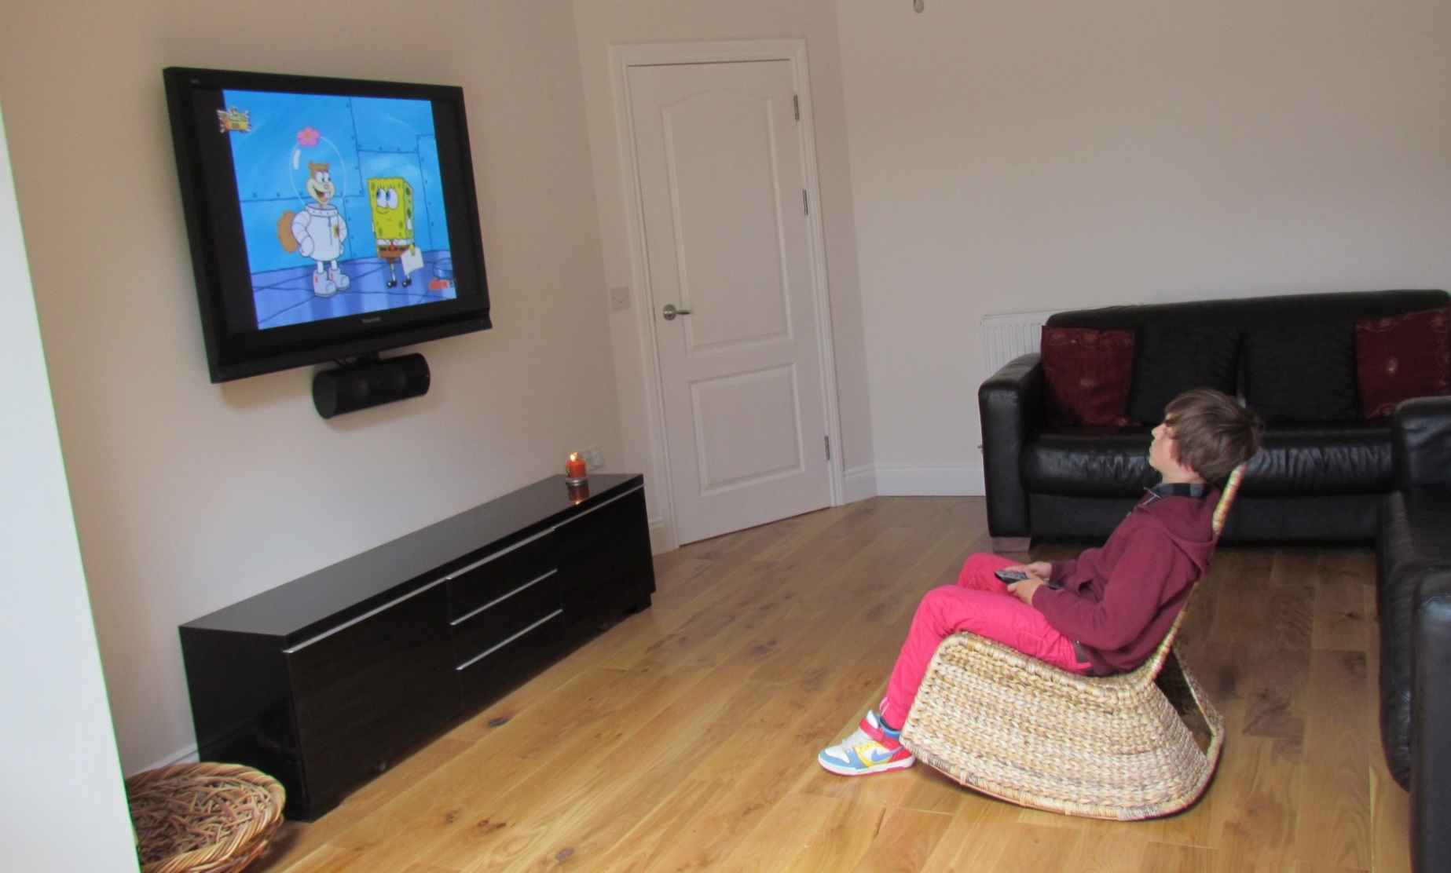
Notes:
Target: il regarde la tele

Slide 17
Gender sorting task
Administered right at the start to check if learners knew the gender of the nouns we were targeting
Shown cards with pictures of target nouns, e.g. ‘crayon’
Researcher said the noun in French, but without the article
Learners had to place each card in a basket marked either ‘La/Une’ or ‘Le/Un’

Slide 18
Motivation/self-efficacy
Self-efficacy – learners’ beliefs in their ability to complete a task successfully
Questionnaire including self-efficacy items for present and future French learning e.g.
How well do you think you will be able to do the following things by the end of Year 7 – e.g. Read a short letter from a French boy or girl and understand what it is about; have a conversation with a real French person
Attitudes to learning French – enjoyment, importance, travel, jobs, looking forward to future learning

Slide 19
Other important data
English literacy (reading and writing) scores
Teacher confidence and training (questionnaire)
Teaching time for French
Parent/carer questionnaire: pupil language background, contact with French, level of parental education

Slide 20
School groupings
Groupings of schools: more difficult than initially anticipated
Questionnaires (Yr5), lesson observations in Years 6
Schools allocated a literacy score from 1-5, based on all these sources (1= very oracy; 5= very literacy)
Score for observation allocated on the basis of KS2 Framework Objectives addressed – gave us two groups
Division less clear-cut than we had hoped
Higher level literacy activities not much in evidence

Slide 21
Results
Small but statistically significant improvement across the time points for gender, SR and PT (grammar and vocabulary)
Statistical significance indicated by * in following slides

Slide 22
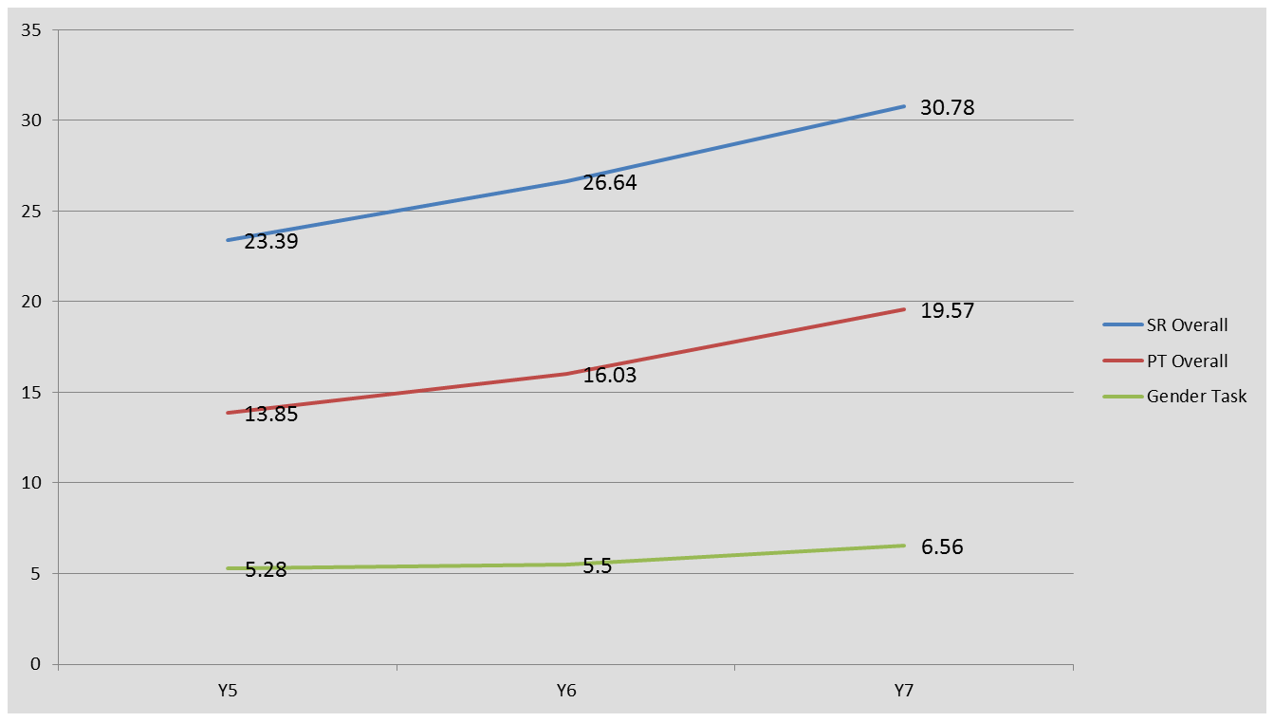
Results by task – years 5-7
Notes:
displays the mean scores for the Gender task for Years 5-7 and from this it is clear that the scores remained relatively stable from Years 5 to 6. However, the learners’ scores did improve significantly from Year 6 to Year 7 (t-test, t= 6.819, df= 159, p=<.001), (Wilcoxon z=6.066 p<.001).
The overall scores on the sentence repetition task show that the learner scores increased steadily across the three rounds. A series of paired-samples demonstrate that the learners made significant overall improvement in both the Sentence Repetition and Photo Description tasks round on round.
Did make progress across transition despite previous studies finding to the contrary.

Slide 23
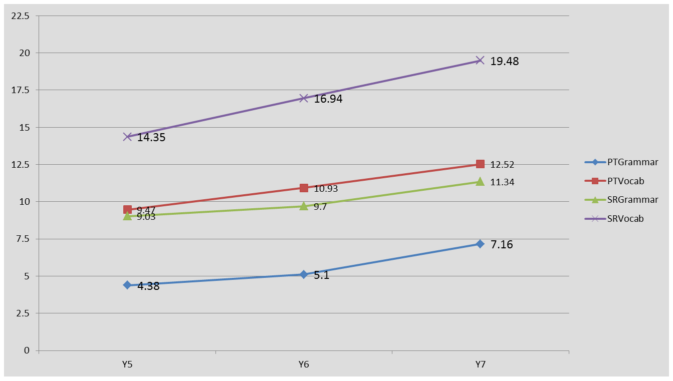
Results – grammar vs vocabulary - sentence repetition and photo description
Notes:
An analysis of the scores related to grammar and vocabulary of both the Sentence Repetition and Photos Description tasks (figure 2 below) indicate that the learners made steady progress in both areas of linguistic knowledge; although grammatical knowledge developed at a somewhat slower pace between Years 5 and 6. Moreover, the learners made statistically significant progress in both vocabulary and grammar across both tasks
Scores out of
10 for gender
For SR
54 for PT

Slide 24
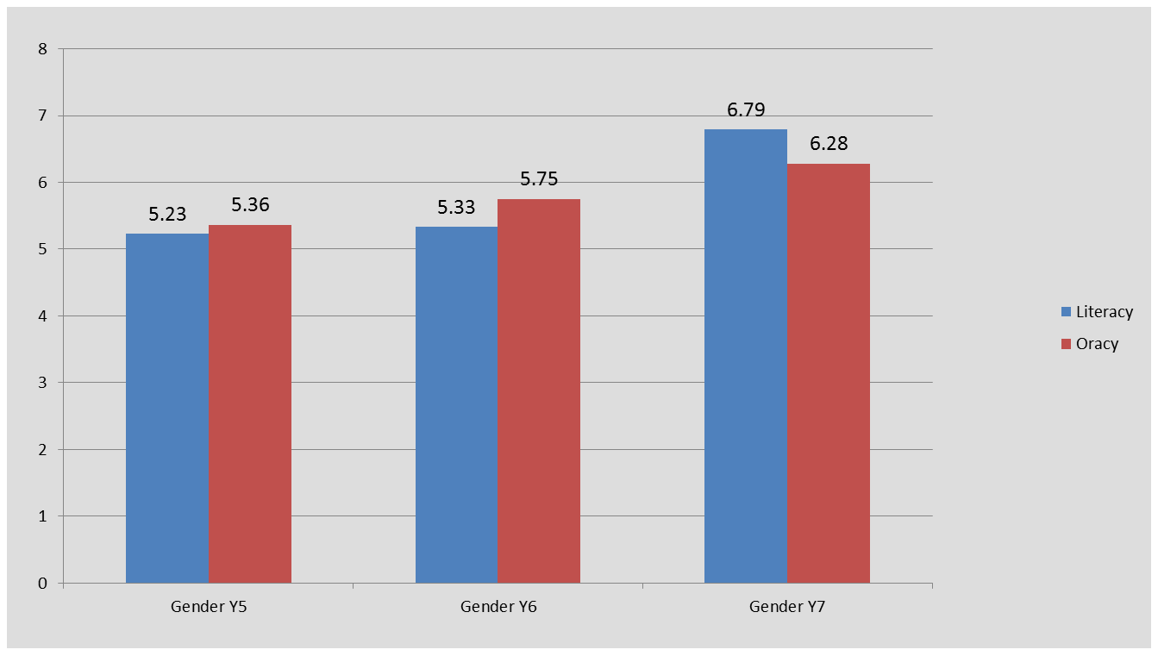
Results – effect of teaching approach gender task

Slide 25
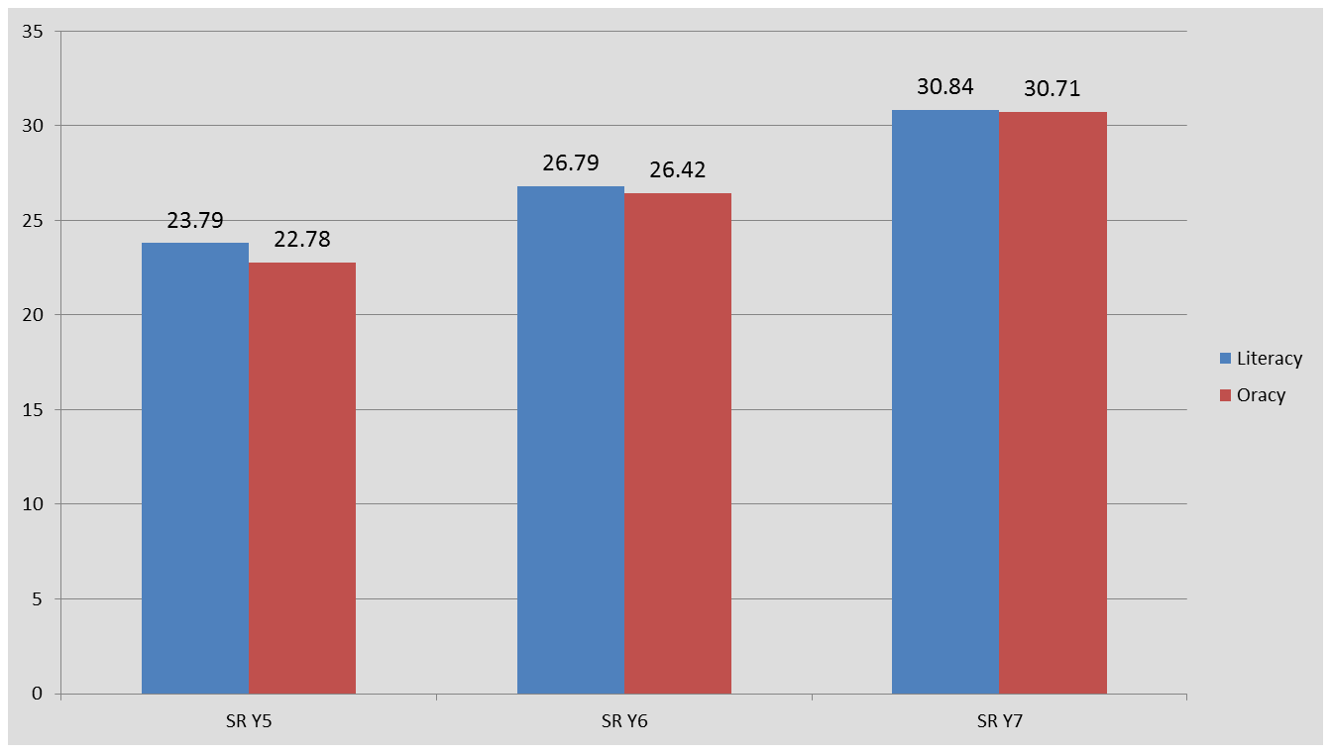
Results – effect of teaching approach sentence repetition task

Slide 26
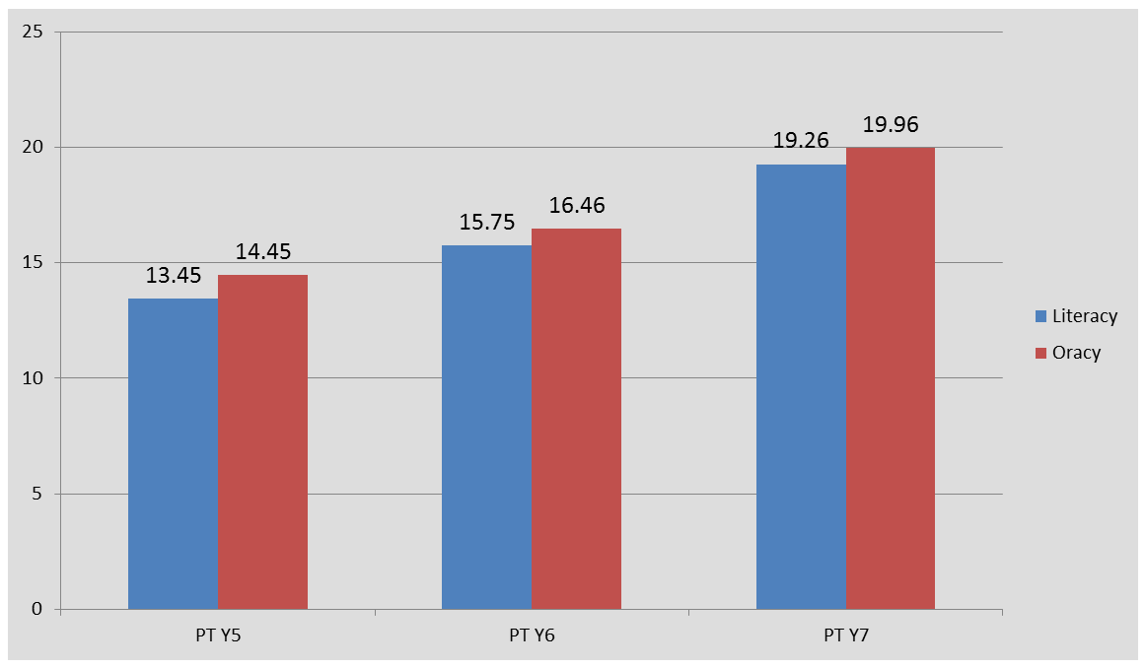
Results – effect of teaching approach photo description task
Notes:
No significant differences between the two groups of learners overall
Kind of literacy activities seems to matter

Slide 27
Differences by approach/task
Some differences detected when vocabulary and grammar scores for SR and PT looked at separately:
In the PT task the oracy learners always outperform the literacy learners for grammar and significantly so in Rd3 (Year 7)
However, the literacy learners score significantly higher for PT vocabulary in Rd 3, and are more confident on part of the task, AND:
For SR task, literacy learners always ahead on grammar
Notes:
SR task maybe a better test of grammatical knowledge?

Slide 28
ALSO:
Some indication that learners with low English literacy may benefit from a literacy approach
Other factors more important than approach:
Individual factors
School factors –learning outcomes significantly correlated with the amount of teaching time
Teacher : learning outcomes significantly correlated with the teacher’s level of French and with teacher’s level of MFL training.

Slide 30
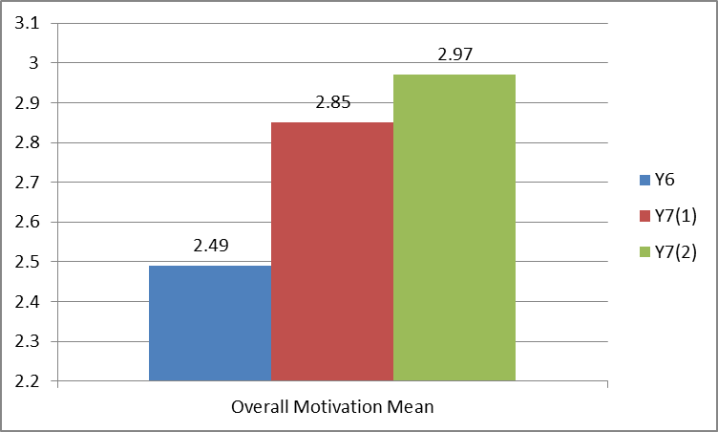
Motivation over time
Overall motivation means (attitudes+ self-efficacy)

Slide 31
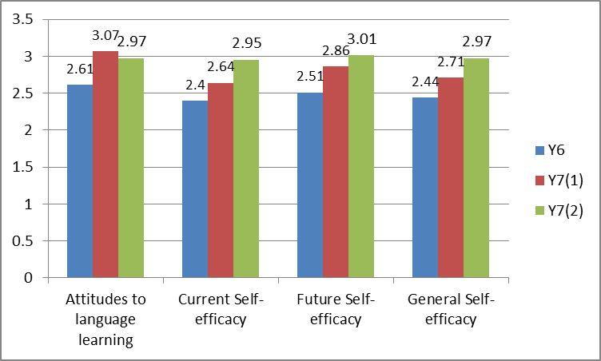
Overall motivation broken down
NB General self-efficacy = current and future self-efficacy combined

Slide 32
Differences in approach
Scale | Year 6 |  | Year 7(1) |  | Year 7(2)
 | Literacy | Oracy | Literacy | Oracy | Literacy | Oracy
Overall motivation | 2.45 | 2.55 | 2.83 | 2.87 | 3 | 2.94
Current Self-Efficacy | 2.32 | 2.52* | 2.6 | 2.7 | 2.92 | 2.99
Future Self-Efficacy | 2.49 | 2.54 | 2.87 | 2.84 | 3.08 | 2.93
General /Total Self-Efficacy | 2.38 | 2.53 | 2.69 | 2.74 | 2.98 | 2.97
Attitudes to language learning | 2.61 | 2.6 | 3.06 | 3.08 | 3.06 | 2.88
Notes:
Only difference attributable to approach is a significant difference for current and general self-efficacy for oracy learners in Year 6 – however, this difference has disappeared by yr 7

Slide 33
Broader classroom experiences more important than approach?
At start of Year 7, all aspects of attitudes towards learning French had improved compared with Year 6
Consistently, the highest level of agreement was French for travel abroad – learners’ main goal for language learning?
By end of Year 7, all aspects of attitudes towards learning French declined (except travel) – YET
89% of learners claimed to prefer French at secondary school

Slide 34
Attitudes * - compared with previous round
 | Year 6 Mean response | Year 7(1) Mean response | Year 7(2) Mean Response
Enjoyed French lessons? | 2.30 | 2.94* | 2.87*
Looking forward to future French learning | 2.24 | 3.13* | 3.06
Notes:
Interesting to look at individual aspects of motivation at each time point – again, mainly much higher for yr 7 at the start – decrease in certain areas (enjoyment, looking forward) inspite of higher overall motivation.

Slide 35
Attitudes: * - compared with previous round
Learning French… | Year 6 Mean response | Year 7(1) Mean response | Year 7(2) Mean Response
Is important | 2.95 | 3.09* | 2.99
Is fun | 2.49 | 3.03* | 2.93*
Will help get a good job | 2.33 | 2.75* | 2.63
Will help for travel abroad | 3.41 | 3.55 | 3.55
Notes:
Year 6 – lower level of ‘enjoyment’ than ‘fun’; not the case in year 7
End of year 7 – less sense of importance, fun, good job; plateauing re travel abroad

Slide 36
Future self-efficacy a clue to attitudes?
At end of Year 6, only 41% felt they would do quite well or very well the following year
Overall, future self-efficacy levels increased between Year 6 and start of Year 7 at a statistically significant level – BUT
No significant increase between the start and end of Year 7 – stagnation in expectations of future progress?
Lowest score for future ability to hold a conversation with a real French person, at all time points – a mismatch between learners’ goals and what classroom equips them to do?

Slide 37
Likes…(most frequently mentioned items)
Year 6 | Year 7 (1)
Learning/specific topics (84) | Learning/specific topics (42)
Games/fun (68) | Progress (27)
Songs (45) | Teacher (25)
Creativity (34) | Games (22)
Cultural aspects (25) | Fun (16)
Technology (22) | Speaking (14)
Writing (purpose) (14) | Interaction (11)
Notes:
Analysis on-going – overview only

Slide 38
Dislikes….
Year 6 | Year 7
Nothing (49) | Nothing (62)
Lack of variety (41) | Writing (19)
Difficulty (33) | Revision (17)
Writing (30) | Difficulty (14)
Lack of progress (20) | Class factors (7)
Songs (16) | Tests (6)
Speaking (13) Reading (12) | Teacher TL (5) Other teacher factors (5)
Notes:
Analysis on-going – overview only

Slide 39
Do you prefer how you learn French at secondary school or how you learnt French at primary school?
11% preferred Primary French
89% preferred Secondary French
Main reasons for preferring Secondary:
Learn more/challenge (46)
Topics (44)
More interesting/fun (27)
Games (14)
Group work (13)

Slide 40
Would like to change about secondary French:
Most frequently mentioned -
More fun/games (17)
More group work (10)
More interaction (10)

Slide 41
Conclusions
Progress and increased motivation across transition phase – contrary to previous research findings
Progress is statistically significant but small– important from an assessment perspective
Importance of individual factors + teaching time/teacher training/teacher French
No one approach clearly better than the other, but maybe nature of literacy tasks used?

Slide 42
Conclusions
Sense of progress important for motivation
Sense of stagnation and repetition a potential problem at primary level
Sense of difficulty, however, equally problematic
Secondary may give greater sense of making progress, but attitudes?
Need for continuing enjoyment and interaction, and an alignment between learners’ goals and teaching focus

Slide 43
Literacy objectives
Eg:
L3.1 Recognise some familiar words in written form
L3.3 Experiment with the writing of simple words
L4.2 Follow a short familiar text, listening and reading at the same time

Slide 44
Literacy objectives
L5.1 Re-read frequently a variety of short texts;
L5.3 Write words, phrases and short sentences, using a reference
L6.1 Read and understand the main points and some detail from a short written passage
L6.4 Write sentences on a range of topics using a model

Slide 45
Individual factors influencing outcomes

Slide 46
Background – early language learning
Over the last decade there has been a global expansion of early language learning (particularly for learners of English)
Learning a foreign language in primary school has been compulsory in England and Wales since September 2014
ELL considered as an effective way to generate long-term, durable and favourable attitudes to language learning
Expectation that ELL will play an important role in motivating pupils to choose to continue language learning at post-compulsory phase
Notes:
Why is it important to research this population?

Slide 47
Background – early language learning
The provision of early language programs is often based on the assumption (from naturalistic language learning) that young learners find language learning easier and enjoyable
Two key studies of early language learners show that there is variability in both levels of motivation and outcomes:
Cable et al. (2010) – Evaluation of language teaching in 40 schools in England
Enever et al. (2013) – ELLiE project – European evaluation of early language learning in 7 countries including England

Slide 48
Individual differences and young learners: motivation
Young learners are described as enthusiastic, interested and highly motivated (Cable et al. 2010)
They tend to find lessons inherently enjoyable and interesting with songs and games frequently liked, along with creative and interactive activities. However, dislike of literacy-based activities has been reported (Courtney 2014)
Young learners often perceive themselves as good at languages but become more realistic of their own abilities as they grow older (Mihaljevic Djigunovic & Lopriore 2011)
Many see wider value of learning languages and see a real purpose for communication at home and abroad (Heinzmann 2013)
Notes:
L1 literacy and L2 outcomes has been shown to be significant – motivation and willingness to study over a long period of time are also crucial for success.
Studies of young learners motivation, by and large, demonstrate that such learners display more positive attitudes than in older learners.

Slide 49
Individual differences and young learners: motivation
Mihaljevic Djigunovic & Lopriore (2011) report that only 4% of learners held negative views at the start of the study but increased to 12% after 3 years
Cable et al. (2010) found that Y3 learners held the most positive views with 98.5% stating that they enjoyed the lessons. By Y6 this had decreased to 74.6%
In several studies learners report making ‘baby steps’ in progress and mirroring the frustration with the lack of progress observed by Macaro & Erler (2011)
More proficient young learners report more positive attitudes (Tragant 2006)
Notes:
Notwithstanding the positive results mentioned studies have also observed a great deal of variability in young learner attitudes and motivation over time
As with older learners, there is a significant relationship between motivation and outcomes for young learners

Slide 50
Results - motivation
Scale | Year | Mean & s.d. | Range | % learners scoring 2 or less
Attitudes to learning French | 6 | 2.60 (.57) | 1.17-4.0 | 19%
 | 7 (1) | 3.07 (.46) | 1.71-4.0 | 3.1%
 | 7 (2) | 2.97 (.62) | 1.0-4.0 | 9.1%
Current Self-efficacy | 6 | 2.41 (.66) | 1.0-3.75 | 34.6%
 | 7 (1) | 2.65 (.58) | 1.0-3.88 | 15.6%
 | 7 (2) | 2.95 (.63) | 1.0-4.0 | 10.1%
Future Self-efficacy | 6 | 2.51 (.61) | 1.0-4.0 | 22.5%
 | 7 (1) | 2.86 (.50) | 1.0-4.0 | 7.5%
 | 7 (2) | 3.01 (.59) | 1.0-4.0 | 8.1%
Notes:
As seen in previous studies the mean scores in Y6 show that in general learners held positive attitudes to learning French but a good deal of variation in group means. Sig prop (19%) did not enjoy French, 34.6% having negative perceptions of current ability and 22.5% lacking conf in future abilities.
Good news is that overall attitudes and SE increased in Y7 (atts dropped slightly).
Significant correlations between self-efficacy and enjoyment in all rounds

Slide 51
Individual differences and young learners: gender
A common finding of MFL studies is that girls generally display higher levels of motivation than boys and out-perform boys in assessments
(e.g. Harris & Conway 2002; Stables & Wikeley 1999; Szpotowicz, Mihalijevic Djigunovic & Enever 2009; Tierney & Gallegi 2011)
Notes:
Gender is also related to issues of motivation. Several studies have observed gender differences

Slide 52
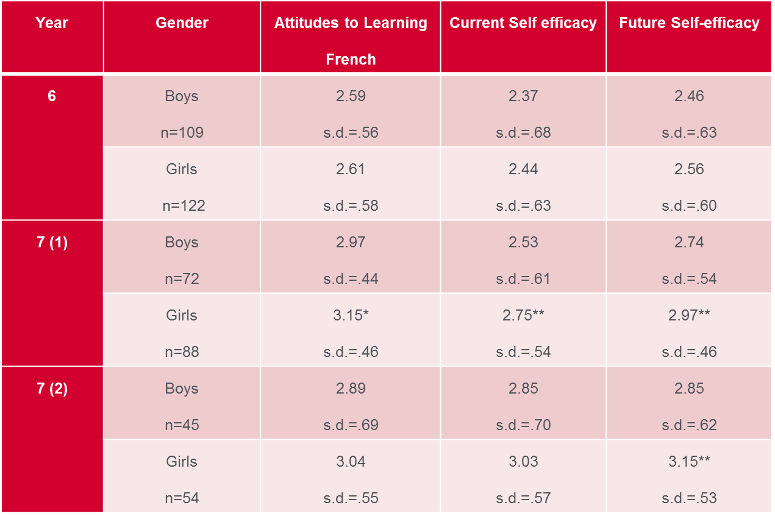
Gender differences – motivation

Slide 53
Gender differences – task results
Task | Year | Boys | Girls
Sentence Rep. mean score | Y5 | 21.06 (9.40) | 25.65** (9.24)
 | Y6 | 24.26 9.36) | 29.05 (9.49)
 | Y7 | 28.56 (9.33) | 32.84** (8.04)
Photo Des. Mean score | Y5 | 11.40 (7.46) | 16.16** (8.09)
 | Y6 | 14.12 (7.84) | 17.85** (7.31)
 | Y7 | 17.68 (8.58) | 21.33** (8.07)
Notes:
Girls also significantly outperformed the boys in both the SR and PT task over the three rounds which again is in line with previous research

Slide 54
Individual differences - L1 literacy
Previous studies have demonstrated a strong link between learners’ literacy levels and L2 outcomes
(e.g. Dufva and Voeten 2001; Sparks 2012)
Courtney (2014) observed that L1 literacy levels became increasingly influential for L2 outcomes by end of first year of secondary school. Focus on literacy in Y7 favoured those learners with stronger L1 reading and writing abilities. No learners received support in deciphering sound/spelling links or word recognition in either Y6 or Y7
Notes:
Those learners with stronger L1 skills in phonology/spelling, GPC knowledge and word recognition accounted for 40-55% of variance in results

Slide 55
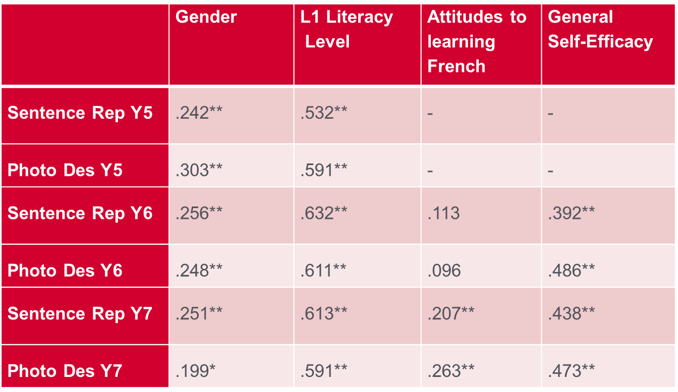
Individual differences - L1 literacy
Notes:
Our data show English literacy to be the factor that correlated most strongly with attainment levels

Slide 56
Motivation and L1 literacy
Learners with high L1 literacy levels held more positive attitudes to FLL but it is in perceptions of ability that differences were significant
Learners with high and med levels of L1 literacy also demonstrated significant increases in self-efficacy but not learners with low L1 literacy levels
Notes:
This variation also includes gender differences clearly emerging at the very earliest stages of language learning. At all time points atts and SE scores were higher for girls than boys (all measures significantly so at beg Y7 – only future SE at end of Y7).
We grouped the learners into 3 groups (high, mid, low) based on their levels for reading and writing in primary school

Slide 57
Interaction of gender and L1 literacy
Girls also significantly outperformed boys as well as being more motivated
However, the mean L1 literacy score for girls (9.14 sd 1.74) was significantly higher than for boys (8.13, sd 1.85; t=4.476, p=<.001)
When L1 literacy was taken into account the differences between girls and boys became non-significant for both tasks in all rounds, except PD task in Y5
Those boys with high L1 literacy levels performed well on both tasks across the 3 rounds and maintained positive attitudes
Notes:
Correlations do not necessarily show complex interplay between variables.

Slide 58
Factors influencing outcomes
For the SR and PT tasks English literacy accounted for 40% of the difference in learner scores across years 5-7
An additional 15%-20% of the difference is explained by school related factors such as teaching time and teacher training
Motivation accounted for a further 3-4% of the difference in learner outcomes
Notes:
Overall view of factors influencing outcomes

Slide 59
Individual factors and learning context
No difference in learners under different conditions (literacy vs oracy)
However we wanted to see how learners with different levels of English literacy abilities performed under different conditions and if there were any differences in their levels of motivation

Slide 60
Results – Sentence Repetition task by learners of all English literacy levels in different conditions
Notes:
Sentence repetition task – high level learners consistently outperform the other two groups (significant?). Middle learners and low learners following comparable developmental trajectories.

Slide 61
Results – Photo Description task by learners of all English literacy levels in different conditions
Notes:
Photo Description task – same as sentence repetition task (although high oracy learners perform better than high literacy learners – is this significant?) Middle learners from both literacy and oracy approach perform similarly whereas low literacy learners make significant gains over those lower learners from oracy schools.
Need to look at data in more detail

Slide 62
Conclusions
The motivation data shows that the widely held view that all young learners enjoy languages is unsupported
A significant proportion of learners held negative views and perceptions of their own ability
For some, the perceptions of ability decreased further by the end of Y7 especially in relation to literacy skills
Girls displayed higher levels of motivation and self-efficacy and these gaps widened in secondary school, particularly for literacy ability
Notes:
Findings demonstrate the significant role that IDs play even at the earliest stages of learning

Slide 63
Conclusions
English literacy levels became increasingly related to L2 outcomes and motivation by the end of Y7 with a widening gap between the least and most able pupils
Results highlight the reciprocal nature of the relationship between English literacy, self-efficacy and L2 outcomes even at the earliest stages of language learning
Notes:
The danger is that, rather than promoting positive attitudes, early language teaching may actually lead many young learners to become demotivated and disillusioned sooner
Trapped in a negative cycle

Slide 64
Conclusions
Emerging evidence that a more literacy-based approach in primary school may help lower ability learners particularly in L2 production
The written form could assist these learners by serving as prop to:
help them retain and recall words
to notice patterns in language input
help them be better prepared for the more literacy-focused pedagogy in secondary school

Slide 65
Conclusions
Important to note that the findings should not be taken as deterministic or used to justify the removal of certain learners from FL study
Work is needed to help schools to devise and adopt teaching practices and interventions to ensure learners of all levels are capable of some success:
Findings related to gender differences into findings of UK National Literacy Trust (2012) that boys achievement in literacy and time spent reading are lower than for girls
Systematic teaching for FL literacy skills (not just phonics)
More equal balance between literacy/oracy activities
Greater differentiation in language lessons (e.g. more time for test taking; allowances for spelling mistakes)
Observed gendered attitudes to FL learning are likely to be mediated by L1 abilities and prior learning experience and not just related to course content
Notes:
The challenge is to ensure all learners feel they are making progress and are able to achieve at some level. The issue needs to be tackled head-on so that learners enter secondary school equipped with positive attitudes and the tools to be successful
Need to look at interactions to avoid overly-simplistic assumptions
Need more nuanced and sophisticated examination of gendered attitudes – not just related to content and predominance of female staff

Slide 66
Thank you for listening!
Any questions?
s.j.graham@reading.ac.uk
l.m.courtney@reading.ac.uk

Slide 67
sources
Board, K. and T. Tinsley. 2014. Language Trends 2013/14: The State of Language Learning in Primary and Secondary Schools in England. CfBT Education Trust Publications.
Cable, C. P. Driscoll and R. Mitchell. 2010 Languages Learning at Key Stage 2: A Longitudinal Study. DCSF
Dufva, M. and M. Voeten.2001. ‘Native language literacy and phonological memory as prerequisites for learning English as a foreign language’. Applied Psycholinguistics, 20: 329-348.
Erler, L. and E. Macaro.2011. ‘Decoding ability in French as a foreign language and language learning motivation’. The Modern Language Journal, 95/4, 496-518.
Harris, J. and M. Conway. 2002. Modern Languages in Irish Primary Schools: An evaluation of the National Pilot Project. Institiúid Teangeolaíochta Eireann.
Mihaljević Djigunović, J. and L. Lopriore. 2011. ‘The learner: do individual differences matter?’ in Enever, J. (ed.) ELLiE: Early Language Learning in Europe. British Council.
Sparks, R. L. 2012. ‘Individual differences in L2 learning and long-term L1-L2 relationships’ in Roberts, L. and A. Meyer (eds.): Individual Differences in Second Language Learning. Wiley.
Sparks, R., J. Patton, L. Ganschow, N. Humbach, N. and J. Javorksy. 2006. ‘Native language predictors of foreign language proficiency and foreign language aptitude’. Annals of Dyslexia, 56: 129-160.
Szpotowicz, M., J. Mihaljević Djigunović and J. Enever. 2009. ‘Early language learning in Europe : a multinational, longitudinal study’, in Enver, J., J. Moon and U. Raman (eds.) : Young Learner English Language Policy and Implementation : International Perspectives. Garnet Publishing.
Stables, A. and F. Wikeley. 1999. ‘From bad to worse? Pupils’ attitudes to modern foreign languages at ages 14 and 15’. Language Learning Journal, 20: 27-31.
Tierny, D. and L, Gallastegi. 2011. ‘The attitudes of the pupils towards modern languages in the primary school (MLPS) in Scotland’. Education 3-13, International Journal of Primary, Elementary and Early Years Education, 39/5, 483-498.
Tragant, E. (2006). ‘Language learning motivation and age’ in C. Munoz (Ed.), Age and the rate of foreign language learning. Multilingual Matters.
UK National Literacy Trust. 2012. Boys’ Reading Commission: The report of the All-Party Parliamentary Literacy Group Commission. National Literacy Trust Publications.

